Slide 1

How do I analyse my context?
About observing, asking questions and getting involved
Dr. Mirjam Laaser
Presentation IPCC, October 2023

Slide 2
Contents
Zooming Out
Where and how and under which question do I want to "do contextualization"?
Keyplayer and Influence Groups
Interfaces and Relationship Constellations
Dealing with Resistance in Change Proceses
Excercises

Slide 3
1. Zooming Out
Bing-Video

Slide 4
Simpsons Universe Zoom Out - YouTube

Slide 5
From Care (yesterday) to Context
CONTEXT 1
Client A
Client B
Client C
Client D
ME
Day 1
Day 2
ME
Client A
Client B
Client C
Client D
CONTEXT 3
CONTEXT 2
Notes:
see society as a part of care package
work with one example
Kinderpalament
you as a consultant
Checkliste?
Gruppenmethode
wer möchte ein Bsp einbringen?
Methoden: Ideenkorb
Stakeholder
ppt
christian context
Fürbitte: petitions als Context tool
Prayers for....

Slide 6
Different realities require different perspectives...
To understand actors in their agency one needs:
an internal view
consideration of the context
And to consider as important that …
…there are different social realities
…these are based on subjective orientations

Slide 7


Slide 9
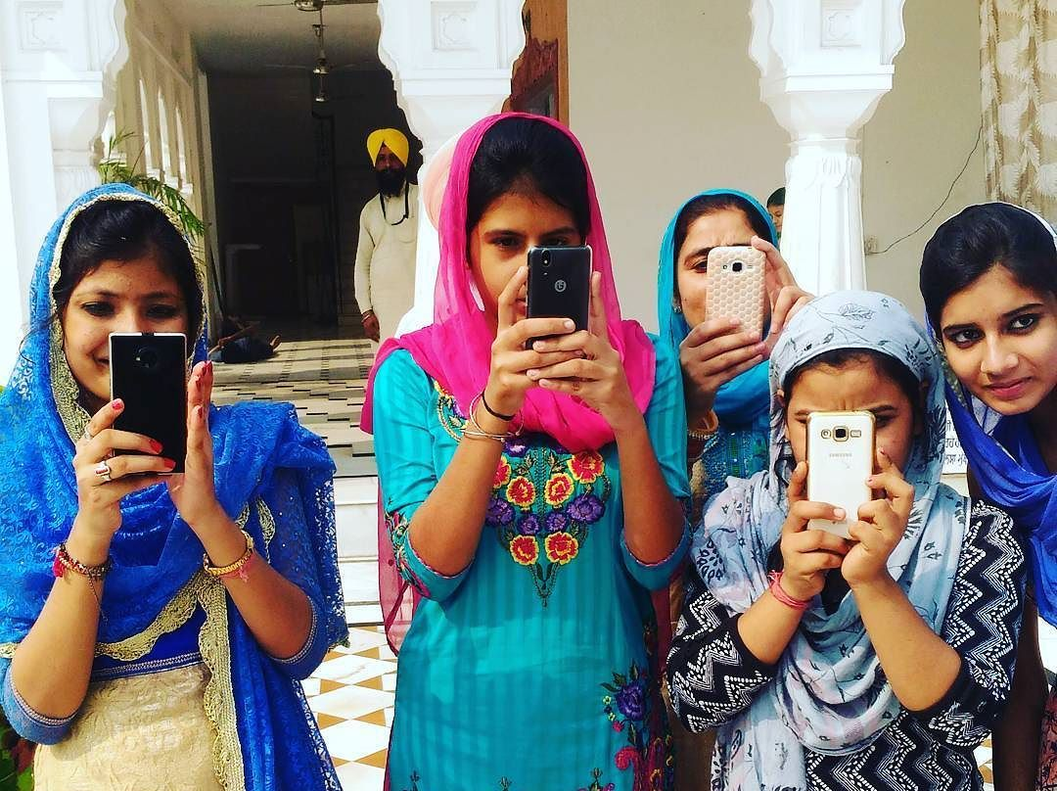

Slide 10
2. Where and how and under which question do I want to
"do contextualization"?

Slide 11
my hypothesis
What is my
question?
how am I going to
get ideas?
New approaches
to counseling
collection information
take into account that ME being there, might have an effect (do no harm!)
Feedback
What do others
say about it?
my conclusions
putting my ideas in a
wider frame/setting

Slide 12
where to look at…
It is usually easiest to find something at
relevant/key players (Teacher; authorities; organisations; religious groups etc.)
Interfaces (where people meet)
In relationship constellations (social networks, kinship relations, obligations between households, production relations, gender relations)

Slide 13
5
3. Keyplayer and Influence-Groups

Slide 14
Key player
Who are key player (people, groups, systems)
If I want to find out about a topic:
What expectations do I have in my role (pastoral care and counseling)
What are the expectations of the key players
Which expectations coincide/where do we find dissent?

Slide 15
?
?
?
ME
?
?
?
My theme ?

Slide 16
Evaluation of force fields
The four most important influencers concerning my question (in my field of influence)
low
interest
high
interest
low
interest
high
interest
low
interest
high
interest
low
interest
high
interest

Slide 17
5
4. Interfaces and relationship constellations

Slide 18
Where to find out something about my question?
Interfaces are the easiest way to see/ask something.
Some examples:
Places where people meet (street, marketplace, pub, shopping, work, etc. - varies greatly depending on country and context).
kinship (you ask a person and then ask them how their parents, grandparents and siblings currently feel about the question)
social networks (circles of friends, etc.)
spatial arrangements (Mapping out the location/ What is available locally?)
Urban/rural relationships (e.g., What networks are there? Does everyone who lives here also work here? etc.).

Slide 19
How to find out something about my question?
Attention
Wide-angle perspective (thinking outside the box)
Simultaneity of inside view and outside view
Self-observation (What is changed by the situation as a result of my being there?)

Slide 20
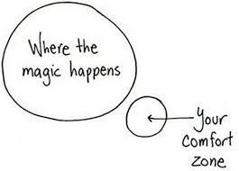
Criteria
Simplicity
Access
not intrusive
allows frequent opportunities
for observation
legal

Slide 21
5. Dealing with Resistance in Change Processes

Slide 22
Resistance as expression of normal process
Action
Explain and guide
Inquire about interests/causes
Adress fears
Make safeguarding agreements
Old identity is defended, because the „new“ triggers insecurity and fear

Slide 23
Resistence as a signal to review one‘s own position
Action
Learn and correct
Admit misjudgements/ shortcomings
Step back and reach consensus
Continue the process with the cooperators
Important factual problems were overlooked.
Ideas are insufficiently communicated

Slide 24
Resistance as expression of a conflict
Action
Negotiation and fighting
Personal conversation with „resistors“
Acknowledge losses
Involve higher levels as supporters or decisionmakers
Asking questions of trust (activatig supporters)
Potential „losers“ of the change process fight for their old position.
Sleeping conflicts come up

Slide 25
6. Exercises

Slide 26
Excercise: Themes
Collection of relevant themes to work on
…
…
…

Slide 27
Exercise: Finding Sites
Make a list of 20 social situations in which you can engage in the form of participant observation.
From these, Choose 5 situations that are most suitable for you as a person, taking into account the selection criteria (simplicity, non-intrusive, allowed, frequent).

Slide 28
Exercise 3: Interviewing a key player
Focused or topic-centered interviews) are:
the use of an implicit list of questions (rough list of topics I want to address)
"narrative-generating" questions (Do you have siblings? Vs. How many siblings do you have and where do they live?)
easy to find out things about your context
interviewing “experts” for the respective topic

Slide 29
Excercise : finding key player
Finding keyplayer
…in my field of influence
low
interest
high
interest

Slide 30
First steps…
What are your results
Looking for counterparts
…
…
Dialogue formats
…
…
…
…
…

Slide 31
getting started...

