Slide 1
Herbert Moyo
School of Religion, Philosophy and Classics
Pastoral care praxis and Isintu Communitarianism

Slide 2
Pastoral care praxis
Pastoral care is shepherding –ukwalusa in my Ndebele Nguni language(s)
Praxis is application or practice of pastoral care with methodological consideration for contextual realties. Well thought out practice and application. It should be a cycle of application, theory (thinking) and application
Pastoral care is the ministry of liberation by pastoral caregivers to people in a variety of bondages through counselling, diaconia and education
Practical demonstration in response to need through love, empathy and compassion representative figures representing God’s love, the church community and the power of the Christ and the Holy Spirit
Seeks to help in developing coping mechanisms through diaconia and pastoral conversations
The pastoral caregiver is held in high esteem as he/she represent the presence of God has access to what the ordinary person cannot access just as spirit mediums would speak on behalf of the Gods

Slide 3
Community –A community is:
a collection of people who interact with one another and whose common interest or characteristics gives them a sense of unity and belonging such as church, political party, language, culture and or
a group of people in defined geographical area with some shared identity, values, norms, communication and supporting behaviors
a collection of people, although they are widely scattered geographically, can have an interest or goal that binds the members-together - common interest community.
  Such can be local, national, continental or global. These can meet through emails, physical, zoom/teams, Facebook, etc.
  Church community, LGBTQ community, refugee community, etc.
Let me use the –Isintu based Nguni community as an example of what community is and how it affects pastoral care

Slide 4
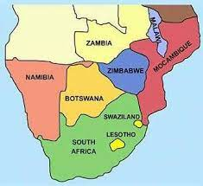
Nguni
Language & Location
Languages
  Zulu, Xhosa, Ndebele and Swati
South Africa
  Zulu, Xhosa, Ndebele and Swati
Zimbabwe
  Zulu, Xhosa, Ndebele
Swaziland/Eswatini
  Swati
The Nguni elsewhere
  There are some traces of the Nguni in Botswana, Malawi, Zambia and Mozambique
Pastoral caregivers to use language accessible the community people for meaning making

Slide 5
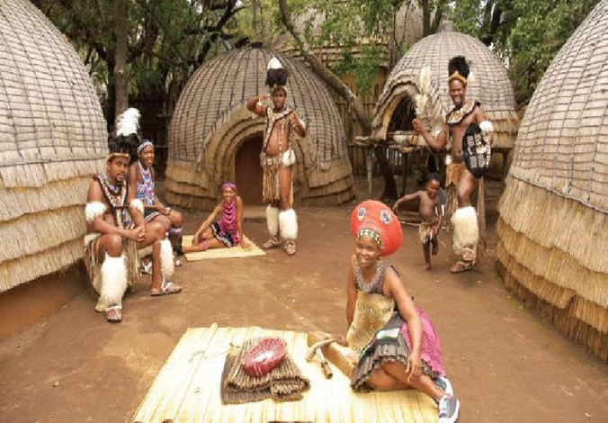
Major Religions amongst the Nguni
Pastoral care givers must be aware of other religions and christian traditions that make up the community
African Indigenous (Traditional) Religions
Christianities
  Western Missionary Initiated Churches
  African Indigenous Churches
  African Independent Churches
  African Initiated Churches
  Ministries
Islam
Hinduism
Judaism
Learn to offer some forms of
pastoral care to all

Slide 6
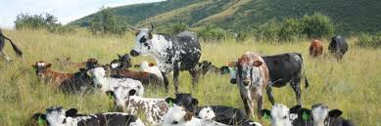
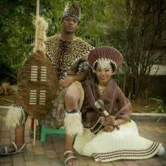
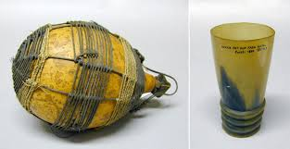
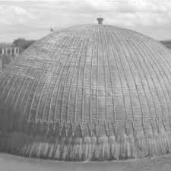
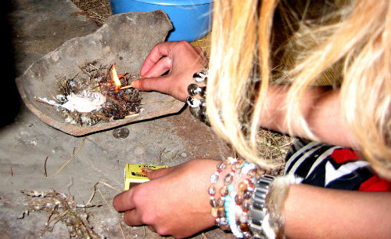
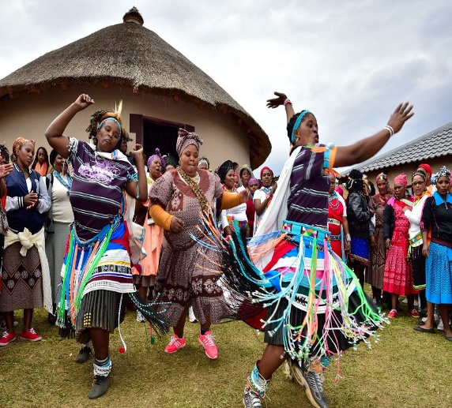
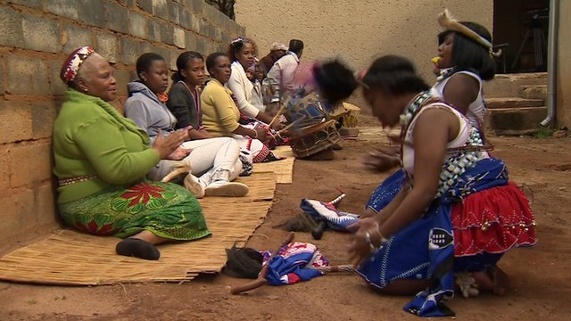
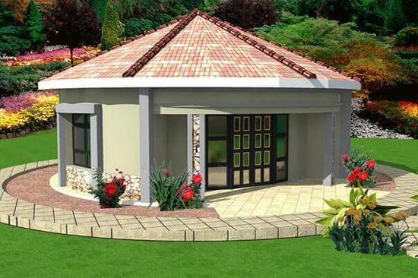
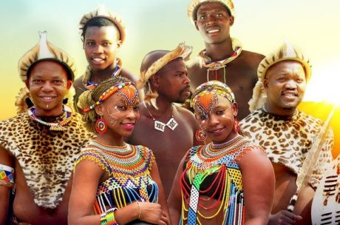
ISINTU
Isintu –normative Nguni way of life
Isintu is the living out of one’s life as a continuous practice of beliefs, customs and culture. –the Nguni normative lifestyle
Isintu involves the economy, dressing, respect for the living and the dead, marriage, death, building homes, celebrations and food
The totality of being, religio-cultural realities, cosmology/worldviews
Life lived through a variety of rituals, observances and behavioural patterns that can be referred to as customs, tradition, culture or religion
Everyday life must always be pleasing to the living and to the living dead
The variations of Isintu principles and values are also practiced by the Sotho, the Pedi and Tswana (found mainly in Zimbabwe, South Africa, Lesotho, Botswana). The Shona, the Tonga, the Chewa, Ovambo, Rozwi and the Venda (found mainly in Zimbabwe, Zambia, Malawi, Mozambique, Namibia and South Africa).
The community lives Isintu and is at the same time isintu

Slide 7
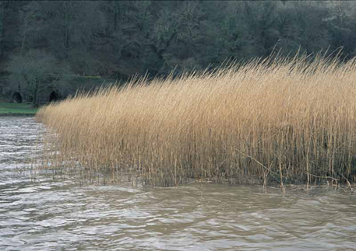
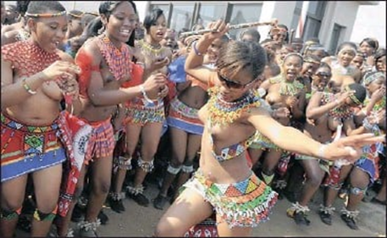
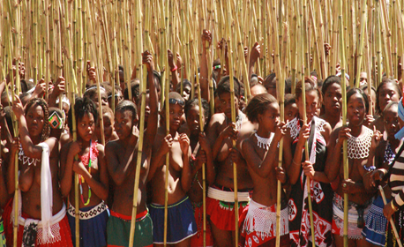
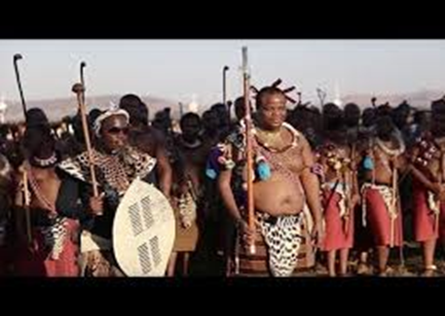
Human origins
Community based responses to challenges are usually those that seek for the origins of humanity
Pastoral care to offer affirmation of some community worldviews that help people cope of their existential realities
Humans originated from a Emhlangeni
Big river and a bed of reeds (community)
You can now think of human sexuality - the river and the reeds
Annual Reed dance/festival – celebrating the continuity of life
Young girls that have reached puberty are a demonstration of the ever-flowing river that can sustain the reeds to produce life
There is no God in the creation story
It is not clear what makes humans pope out from the river and the reeds
There after people come from their ancestors

Slide 8
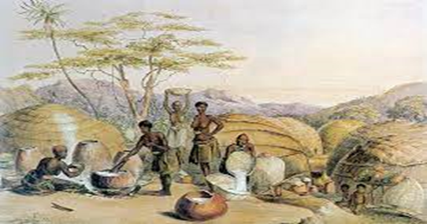
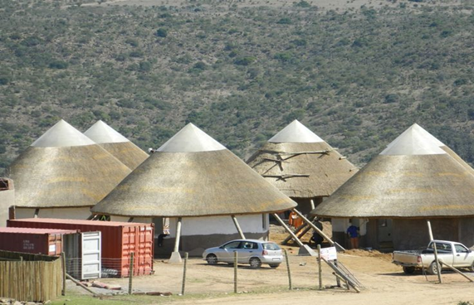
Isintu Communitarianism
Life is lived in community – I am because you are - Umuntu ngumuntu ngabantu – you cannot be human alone
Community of good spirits and bad spirits
The have and the have not
Isintu is hinged around care for the other through sharing and communal respect and responsibility
Ilima (Doing things together as a community especially in the fields), ukusisa (offering neighbours cattle for farming, milk and dignity) and ukusiza (helping one another)
Care for the vulnerable – the old, the young, travelers/foreigners and visitors –Ubuntu
Interdependence
Shared responsibility – Galatians 6:2 calls us to “bear one another's burdens and to truly hurt along those who are hurting.”

Slide 9
Isintu communitarianism
In Isintuism my neighbor's problem is my problem and my neighbour’s joy is mine too
What affects the individual affects the community and what affects the community affects the individual therefore pastoral responses must speak to both the individual and the community for better coping outcomes
An individual cannot be understood separately from the community (in this case community may mean nuclear family or extended family or village or congregation, etc.)
Apostle Paul has a good picture of communitarianism in I Corinthians 12: 24- 26 “…God has put the body together, giving greater honor to the parts that lacked it, so that there should be no division in the body, but that its parts should have equal concern for each other. If one part suffers, every part suffers with it; if one part is honored, every part rejoices with it.” -
When the Nguni greet, we do so in the plural even if I am talking to one person. Sanibonani or Salibonani (Hallo in the plural/I see you) and then Ninjani/Linjani (how are you? – again in the plural). The respondent says “Yebo (Yes, hello)” and then “siyaphila –we are well – this again in the plural from this single respondent.” In other words, we greet this person we are meeting together with all those connected to the person such as the community, family members, neighbors, church members/religious group one belongs to, and work mates. If any of the above is not well, the person will say ‘we are not well, my neighbor is suffering through...’
In pastoral care we have linked Isintuism to the biblical text on ‘…love your neighbour as yourself. Matthew 22:39 – A community full of natural love does not need education on how o care for each other in times of need. Those who care have ubuntu (they are humane), the opposite is ubulwane (being like a wild animal)

Slide 10
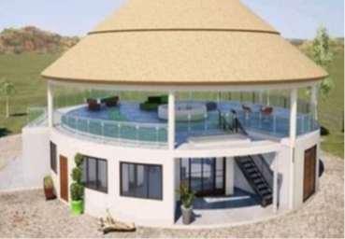
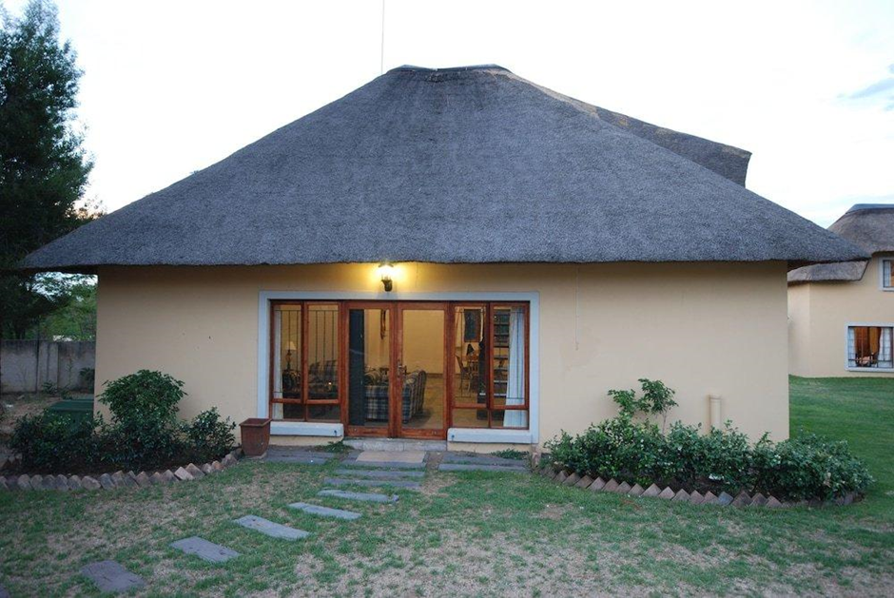
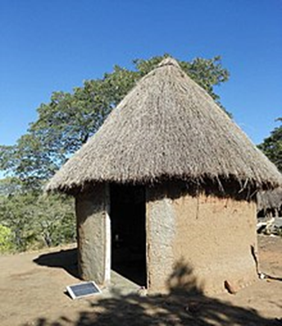
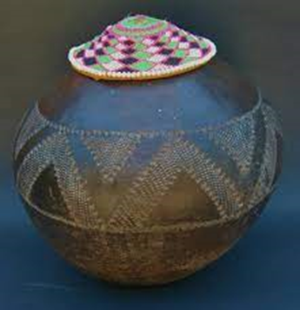
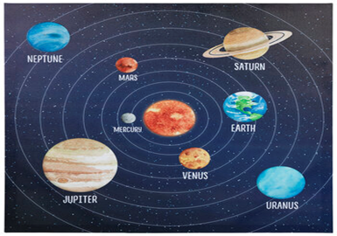
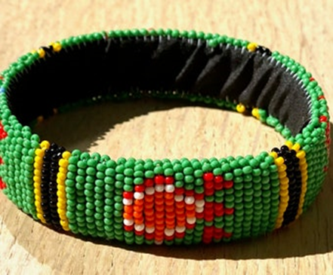
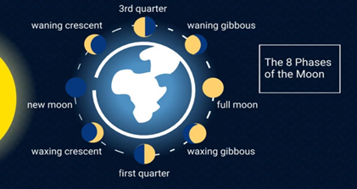
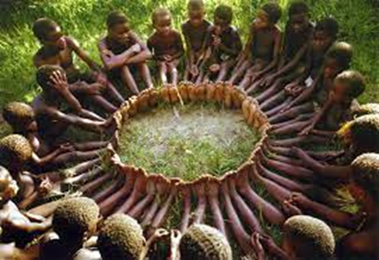
Nguni cosmology
Cosmologically, the Nguni believe that everything is cyclic, implying
  endlessness, continuity and perpetuity of cycles in nature including human life
The circle is a basic shape for almost everything such as the house (the hut), cattle kraal, water well and musical instruments
The circle by Nguni imitates nature
  Planets & Solar system
  Phases of the moon & menstrual cycle of women
  Seasons
  body in itself including limbs are cylindrical
Actions that depict the circle worldview
  Sound of musical instruments is repetitive
  Music is repletion of the same phrase
  Dancing repetitive and usual in a circle
  Playing games
  War formation, hunting, etc.

Slide 11
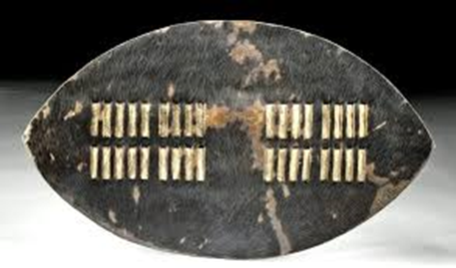
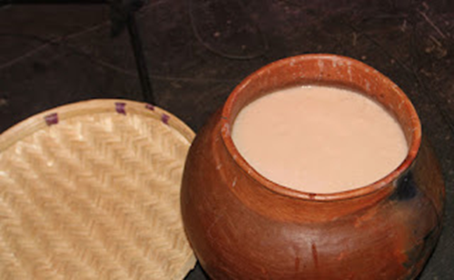
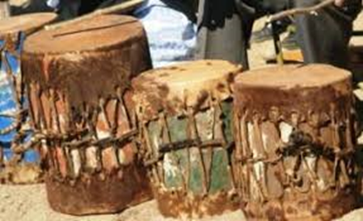
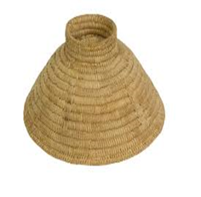
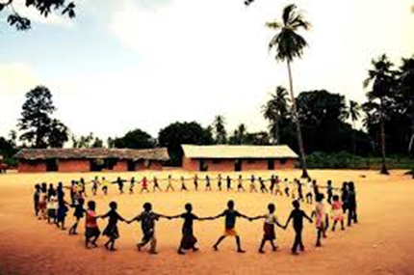
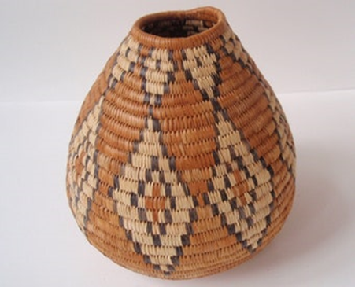
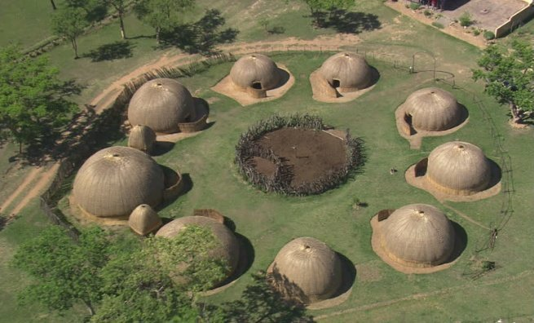
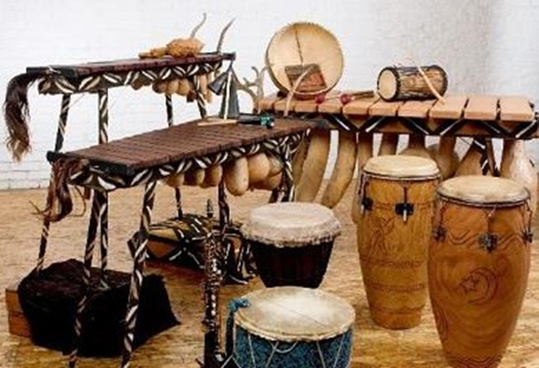
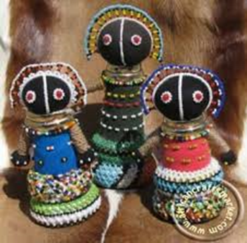

Slide 12

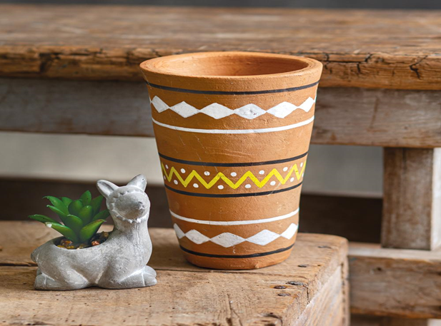
Rituals on continuity & interconnectedness
Birth – Reproduction is central hence the chevron decorative symbol in Nguni art
  Always seeking for solutions to barrenness
Puberty – celebrated e.g. Umkhosi womhlanga
Death
  Is not the end of life – going back to ancestors
  Ukubuyisa –to bring back/to bring home
  Ukutshala/Ukutyala –Planting/sowing
  Ukufihla – concealing
  Ukubeka - keeping
Amadlozi or abaphansi or ithunzi or izinyanya – ancestors

Slide 13
Communitarian Interconnectedness & pastoral implications
An injury to one is an injury to all (inja one inja all)
What affects the community at the physical level is connected to the spiritual (imimoya both evil spirits and holy spirits)
The living are connected to each other, to nature and to the spirit world
The church community is intricately inseparably connected to the rest of the community where it is located and beyond
The community of the living is connected to the community of the departed
The Nguni are traditionally concerned about the wellbeing of the departed as they are still part of the cycle of the endlessness of human life. All saints Sunday , tombstone unveiling, easter rituals at the graveyard help Christians remember/reconnect with the departed
Pastoral care therefore means responding to the interconnected community of those in the church and outside of the church.

Slide 14
Public Pastoral care by community-based elders
The volume of work for pastoral are care givers is insurmountable hence the need for laity to participate in pastoral care
They are named differently as per context – local preachers, lay leaders, elders, preachers, pastoral care givers, home based care givers, sub-deacons, brothers/sisters
I offer CPE (Clinical Pastoral Care) training for 100 hours with some hospital experience to these helpers. A variety of churches sponsor their laity for the CPE so their lay pastoral helpers can offer meaningful pastoral presence to the sick, traumatized and the bereaved or any other pastoral need. Some conduct Sunday services and funerals in the absence of the ordained pastor
They are trained on basics such as listening, responding, ministry of presence, verbatim reports and analysis, keeping records, confidentiality, use of prayer and biblical texts, some counselling skills, sermons/homiletics, emotional intelligence and pastoral conversations grounded in love, empathy and human vulnerability
They are trained on the skill of how to make referrals mainly to the pastor on complicated cases, but also to other helping professions such as psychologists, social workers, educators and police
Normal we train church members who are already skilled in some way such as teachers, social workers, legal practitioners, nurses/medical doctors, psychologists, police officers and academics. These belong ti the community and they understand the cultural dynamics of the interconnectedness in the community
This is a way of equipping community members to offer pastoral care to other community members as ordained ministers alone cannot be able to meet the demands of their big congregations and the connected communities because of the inja one inja all

Slide 15
Discussion points
Public pastoral care praxis resonates with the Nguni Isintu values and principles. Discuss
What are the challenges facing the church in attempting to do public pastoral care?

