Slide 1


Called to Care…
Carefully

Slide 2


Careful Caring
Caring based in theology
Caring based in practice
Listening as holy art
Questions for discussion on careful caring

Slide 3
Are pastors responsible for all
Pastoral Care and Counseling Techniques?
New Testament
  From the very beginning, the Christian community shares in the joy and pain of one another (Paul’s epistles, but also the Johannine literature, the Gospels of Matthew and Luke)
Augsburg Confession (CA V, XIV)
  The unique task and skill set of the pastor…
  …might not always be of best service in a pastoral care setting

Slide 4
Augustana on Pastoral Ministry
IV. Justification
V. The Ministry of the Church. “In order that we may obtain this faith, the ministry of teaching the Gospel and administering the sacraments was instituted. For through the Word and the sacraments, as through instruments, the Holy Spirit is given, and the Holy Spirit produces faith, where and when it pleases God, in those who hear the Gospel. That is to say, it is not on account of our own merits but on account of Christ that God justifies those who believe that they are received into favor for Christ’s sake…
VII. The Church
XIV. Ecclesiastical Order. “Our churches teach that nobody should preach publicly in the church or administer the sacraments unless he is regularly called.

Slide 5
Are pastors responsible for all
Pastoral Care and Counseling Techniques?
Exception to the rule - sacramental ministry as pastoral care.
  Confession and Absolution (the “third Sacrament” CA XI)
  Holy Communion as an instrument of pastoral care
  Baptism (in emergencies)
Pastoral Care is not the exclusive prerogative of pastors; it is“the obligation of the baptised rather than the privilege of the ordained.”

Slide 6
Pastoral Care is frequently the duty of ordained ministers
Why?
  Pastor as expert in all things spiritual
  Pastor as replacement for professional therapist (“psychologist” or even “psychiatrist” - “lite”)
    Costs associated with professional care
    Stigma of mental health problems
      Taboo issues in a given culture – addiction, sexual issues
  Reasons in your contexts?

Slide 7
The Holy Art of Listening in
Pastoral Care and Counseling
God’s openness towards and concern for humanity (listening to prayer) is the model for listening to our fellow humans. God demonstrates Divine love by listening to us when we pray. By analogy, we are to show our love for our brothers and sisters by listening to them. (Bonhoeffer. Life Together)
Speaking to a good listener might be experienced in a way analogous to a sense of being heard in prayer.
Unique in pastoral care and counseling – listening with “both ears,” attuned both to our conversation partner and to the sometimes still, small voice of God. Pastoral care is about building a bridge of communication and understanding between the Holy One.

Slide 8

“Active Listening” in Pastoral Care

Slide 9
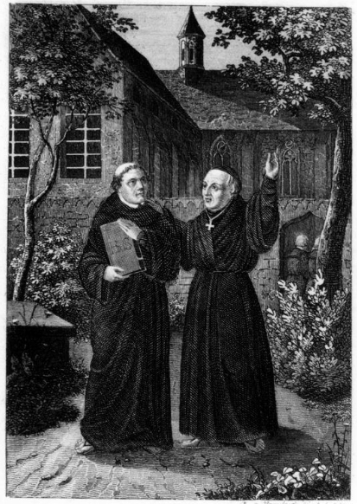
Staupitz and Luther: a model for listening, intervention, and continuing care
“If it had not been for Dr. Staupitz, I should have sunk in hell.”
M. Luther

Slide 10
“Careful caring” - questions for further discussion
What are expectations of a pastoral minister based in theology and (vs.?) expectations of a pastoral minister based in context? How might the former help us interpret the latter?
What are your limits? What local professionals are available for serious mental illness? How do you build a referral network in your context?

Slide 11
“Careful caring” - questions for further discussion
Is it helpful to distinguish pastoral care from pastoral counseling?
Are there skilled lay leaders (elders, people known to be good listeners, etc.) whom we could train in congregations? (Perhaps they’ll never be preachers – and perhaps that is a good thing!) What are the barriers to equipping them with the necessary knowledge and skills?

