Slide 1
Anger
The possible role of pastoral care in issues of anger management

Slide 2
What is anger/wrath?
Anger is a natural, intense emotion characterized by feelings of annoyance, displeasure, or hostility, often triggered by a perceived wrong or threat. It can range from mild irritation to extreme rage and is a normal part of the human experience.
Anger is a feeling that generates energy in a human being. Anger is neither constructive nor destructive. The consequences of anger depend on how the energy generated in used
Anger can be experienced as a feeling where the body reacts through raising the body temperature, a rising lump from the stomach coming up to choke the voice in the throat, burning sensation in the eyes and at times trembling and heavy breathing

Slide 3
The essence of Pastoral care
Many definitions but for the purposes of this presentation, pastoral care is understood as:
The shepherding by pastoral caregivers (both clergy and laity)
Shepherding is looking after, taking care of, stewardship over God’s things including human beings in need for coping mechanisms in a variety of contextual needs
Shepherding comes also in the form of pastoral counselling, chaplaincy and clinical pastoral care.
Shepherding through pastoral counselling brings about reconciliation, mediation, emotional intelligence and emotional management.
Shepherding in the form of pastoral care responses to the consequences of poor anger management such as fights, death, murder, imprisonment, severed relationships and divorce
Pastoral caregivers represent the ideals of the principles and values of Christ
Helping society to be proactive in some issues where possible than to continuously be an ambulance service picking up causalities

Slide 4
A case of poor anger management
I will cite an incident that took place during November 2003: a young mother took an eight months old baby and smashed her head on the wall at Chris Hani Baragwanath Hospital. The baby girl died (Radio 702, November 20, 2003, 7:00 news). She was angry because she fought with her boyfriend, and when asked, she responded by saying that she was trying to hurt the boyfriend by hurting the baby that he loved so dearly.
The above incident reminds me of the book of Isaiah: “See, the day of the Lord comes, cruel, with wrath and fierce anger, to make the earth a desolation, and to destroy its sinners from it … Whoever is found will be thrust through, and whoever is caught will fall by the sword. Their infants will be dashed to pieces before their eyes; their houses will be plundered, and their wives ravished. See, I am stirring up the Medes against them” (Is 13:9, 15-17).
We have experienced smashing of glasses, cars, television sets, walls, smashing of people, etc

Slide 5
Some consequences of lack of anger management in South Africa
Overall, 6,953 murders were recorded over the three-month period (October –December 2024), averaging 75, murders a day.
South Africa recorded 26,232 murders between January and December 2024, averaging 72 murders every day.
A total of 411,600 counts of serious and violent crimes recorded
Domestic violence
Intimate partner violence
Gender based violence
Violent protests
Violent crime

Slide 6
Does Pastoral care and pastoral caregivers have a role to play in issues of anger
The violent acts experienced in RSA are attributed to unresolved anger issues, generational anger, historical political issues, socio-economic issues, and poor anger management by police, social workers, pastoral caregivers/chaplains, social workers and confessions by some perpetrators of violence
Pastoral caregivers just like other social service providers are an ambulance service as they continuously react to the consequences of anger
What role can pastoral care givers play in mitigating poor anger management in society instead of being an ambulance service that responds to causalities anger?
We think this workshop can help us brainstorm collectively on practical implementable possibilities for mitigating the growing tide victims/victors of anger
THANK YOU VERY MUCH

Slide 7
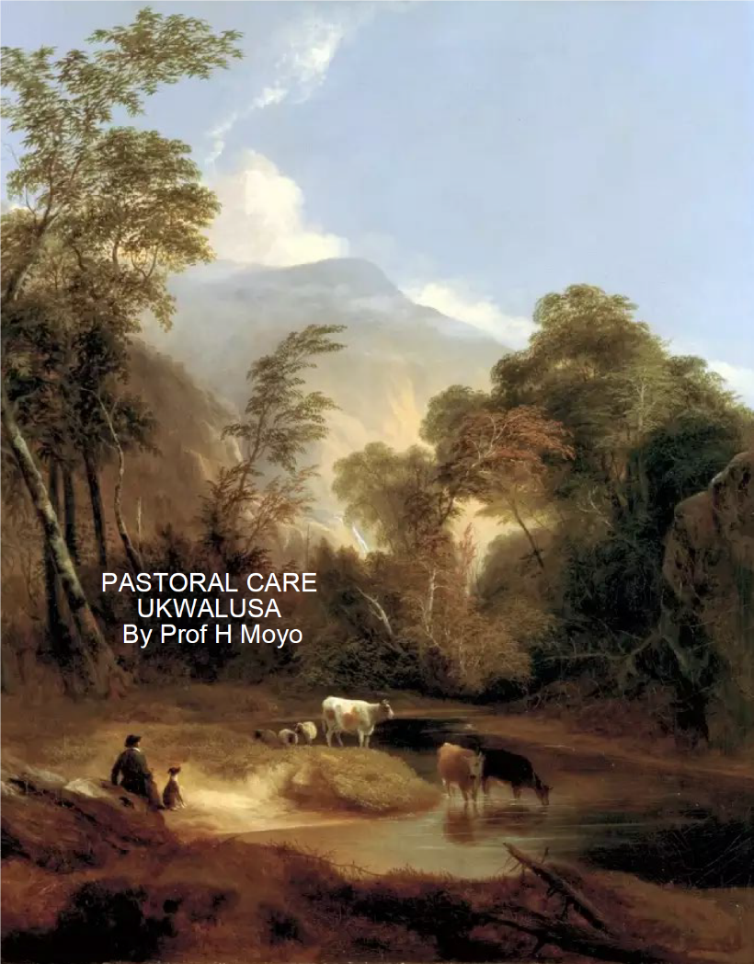
References
Masango, M. J. (2004). Aggression, anger and violence in South Africa. HTS: Theological Studies, 60(3), 993-1006.
Senzo Mchunu – South Africa crime statistics

